Slide 1
AHBC Update To The Select Board
Leif Hamnquist – Chair
Kevin Becica – Vice Chair
October 28, 2025

Slide 2
Tonight’s Presentation
Committee Logistics
Base Bid Plan & Rendering
Key Updates since our last presentation to the Select Board
Committee’s next actions
Questions and Comments

Slide 3
AHBC Logistics
New Committee Launched: July 31, 2025
Current Officers:
Chair: Leif Hamnquist
Vice Chair: Kevin Becica
Clerk: Bob Panessiti
Meeting Frequency: Every 2 weeks
Select Board updates: Next update is November 18th

Slide 4

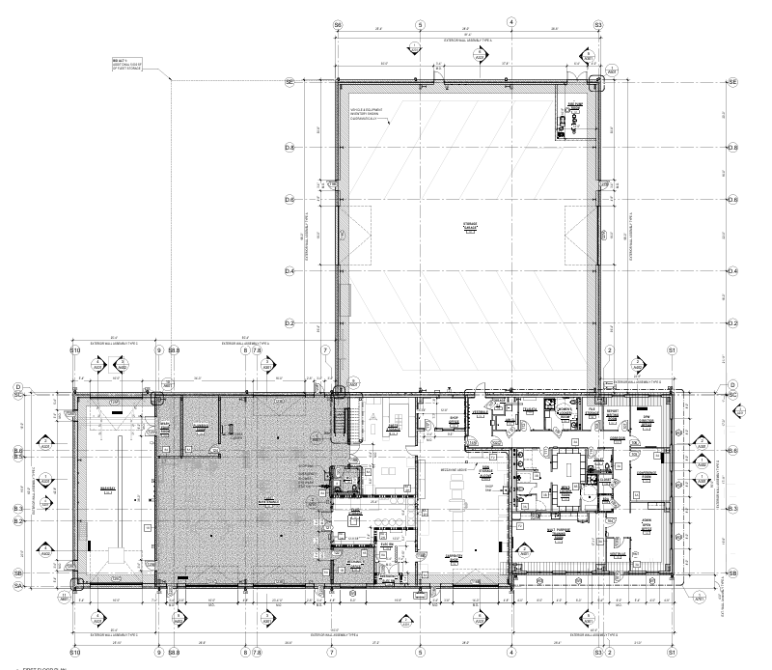





DPW Base Bid Plan View

Slide 5
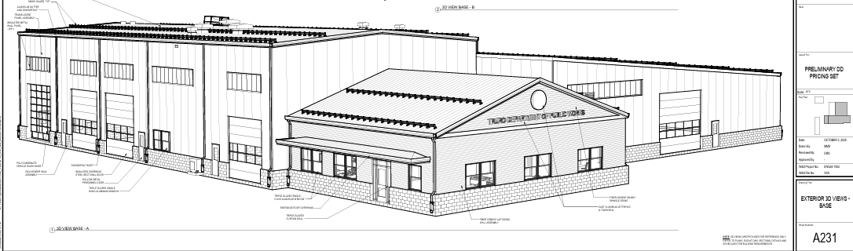
DPW Base Bid Rendering
Facilities In Base Bid
Administration
Building Maintenance
Fleet Maintenance
Wash Bay
Workshop
Vehicle storage
18,945 sf, 2,500 sf mezzanine
Total = 21,445 sf
Wash Bay
WorkShop & Bldg. Maint.
Fleet Maintenance
Administration
Vehicle Storage

Slide 6
Key Updates Since Last Presentation
Design & Bid Document Evolution:
The DPW garage will remain and be phased in, the DPW will move out of the garage in 7 calendar days once notified by the general contractor.
Plantings for the new well site and watermain will be included in the bid document as part of the new well installation.
The DPW will demo all the facilities except the DPW vehicle maintenance garage. This will be reflected in the updated estimate.
The DPW office Demo will need to take place as part of the PFAS remediation and capping project. The DPW Director and Office Manager will relocate to the Safety Facility. This will be reflected in the updated estimate.
The salt barn will be first in the construction sequencing, and this will be reflected in the bid document.
Westin & Sampson are actively scheduling to appear before the Planning Board, Zoning Board and BOH, the initial meetings will be held before the end of the year.
Cost Estimates: Updated cost estimates for the design development phase are expected to be delivered by October 31st .

Slide 7
Select Board & AHBC Approved Design and Bid Document
Base Bid (Approved September 25, 2025)* :
Administration, Building Maintenance, Fleet Maintenance, Wash Bay, workshop areas, Vehicle storage garage totaling 18,945 sf, 2,500 sf mezzanine Total = 21,445 sf
Bid Alternate Order*:
Alternate #1: 5,000 sf Fleet storage Total= 26,445 sf
Alternate #2 4,050 sf standalone enclosed canopy Total = 30,496 sf
*All Scenarios include a New Salt Shed, Generator Septic Treatment & Disposal System for the DPW and Town Hall, PWS Drinking Well with a Water Main for the DPW and Town Hall, Fire Protection Pump Room & Cistern Stormwater Drainage All totals include 2,500 sf mezzanine
Select Board voted to approve AHBC recommendations for the Modified Base and Bid Alternate Order.

Slide 8
Committee’s Next Actions
Community Benefits Narrative: Uniform talking points have been developed for the Ad Hoc Committee and the Select Board. This is a working document that will be updated as we move through the design and bid document development.
Engagement Plan: Community forums have been tentatively scheduled for November 21st and April 10th,2025 from 6:00pm-8:00pm at the Community Center along with smaller DPW facility discussions on the second Wednesday of every month beginning in January 2026 at Town Hall from 6:00pm-700pm.
Ongoing Communication: Continue scheduling regular updates and recommendation checkpoints with the Select Board. AD Hoc Committee members will be reaching out to schedule office hours with Select Board members. Additional outreach via Library, School, and Other Advisory Groups

Slide 9
Questions and Comments

