Slide 1
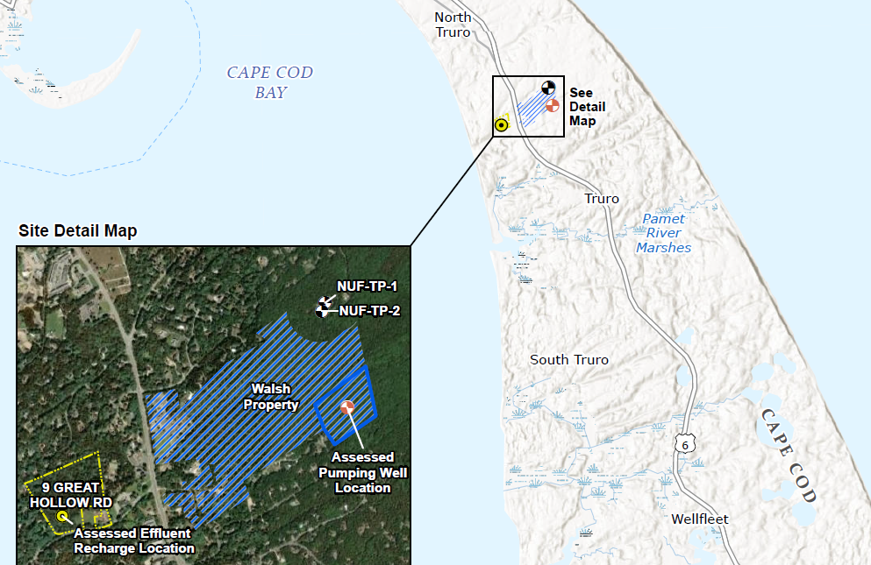
Town of Truro
Preliminary Hydrogeological Investigation
October 8, 2025

Slide 2
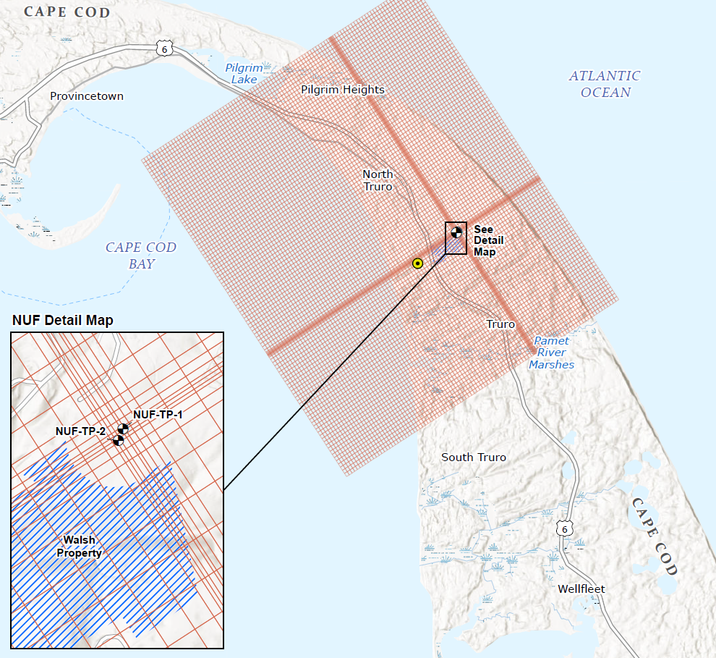
Agenda
Background
Analysis Results
Take Aways
Next Steps

Slide 3
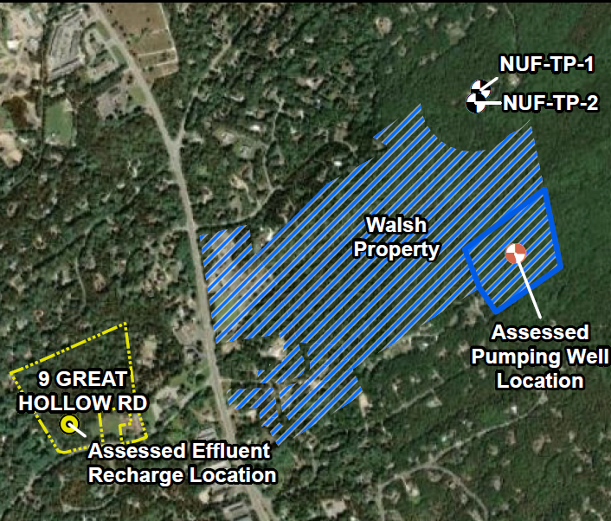
Background
Scope of Work
  Evaluate the feasibility of a community water supply well to provide water to Walsh property
  Evaluated feasibility of 30,000 gpd assumed for Phase 1 of Walsh
  Completed sensitivity analysis for 10,000 gpd and 45,000 gpd
Groundwater Model Development
  Hydraulic model originated as a regional USGS Model
  Updated in 2011 by McLane Environmental
  Subsequent updates in 2018, 2024
  Model provided by Apex
Model simulates
  North Union Wellfield (NUF Wells)
  Proposed wastewater effluent recharge at 9 Great Hollow Road
  GHD work was in parallel to Stantec’s work – School site may need to be revisited

Slide 4
Analysis/Results
Completed various hydrogeological runs to evaluate impact of new well pumping to existing conditions
  Drawdown levels
  Total Dissolve Solids*
  Sodium*
  Chloride*
  *none of these are regulated contaminants but provide insight into comparison to existing conditions
Simulated wastewater effluent recharge at 9 Great Hollow Road
Note: Total Dissolved Solids – measure of inorganic and organic substances. High TDS is not a health hazard but can affect taste, smell, scale build up, etc.

Slide 5
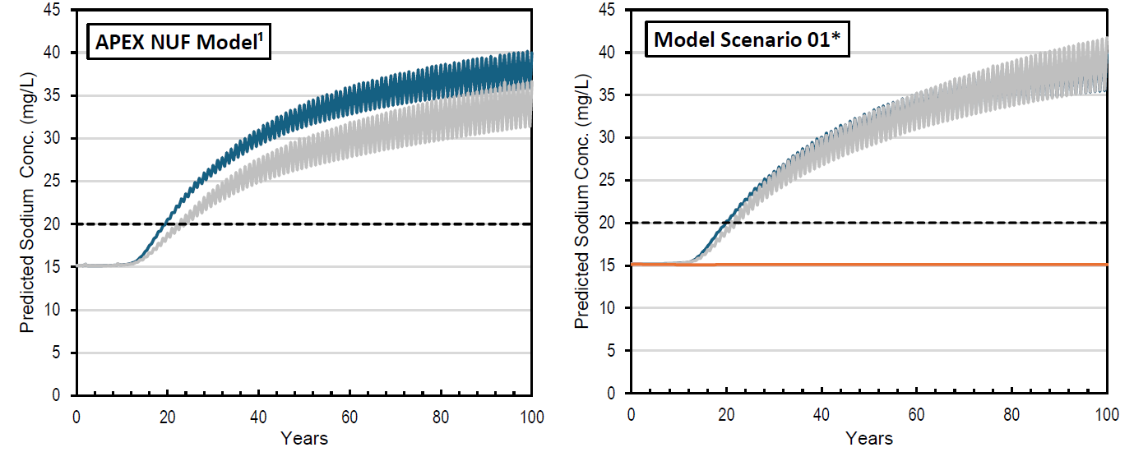
Sodium Concentrations
Baseline – Existing Conditions
30,000 gpd at Quail Ridge
 | 20 years |  | 40 Years
 | TP-1 (blue) | TP-2 (grey) | TP-1 (blue) | TP-2 (grey)
Baseline | 20 mg/L | 18 mg/L | 30 mg/L | 26 mg/L
30,000 gpd | 20 mg/L | 19.5 mg/L | 30 mg/L | 29 mg/L
Table values are approximate/ rounded
TP 2 (grey) reaches 26 mg/L about 5 years earlier (35 years vs 40 years)

Slide 6
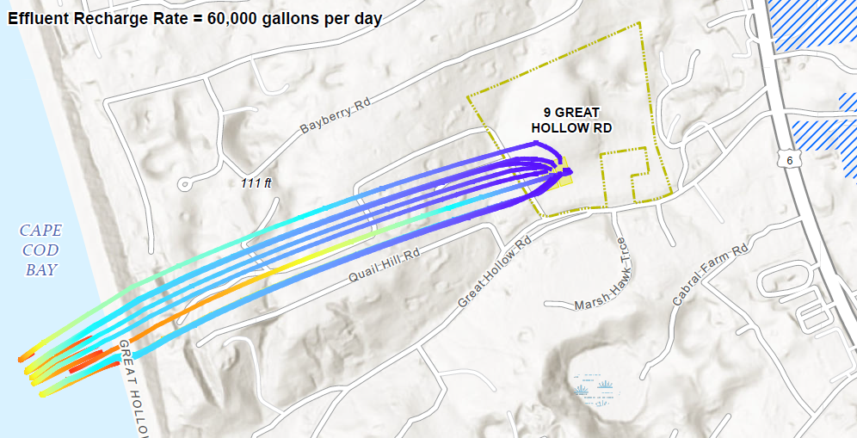
Wastewater effluent recharge

Slide 7
Take Aways/Next Steps
Some impact to NUF wells according to model
Impact is proportional to pumping
Unclear at this time what MassDEP would say about impact to NUF wells
Process to advance the well source has numerous steps, recommend engaging with MassDEP to understand how they would evaluate this impact
Permitting Steps:
  Source Water Approval Process
    Groundwater Exploration (Drilling)
    Request Exam / Pumping Test Proposal to MassDEP
    MassDEP Review of proposal
    Pumping (Aquifer) Testing
    Analysis of Testing Results
    Report
      Includes design plans for permanent works

